Slide 1
Contents
Magnetic field induced by a moving point charge
Magnetic field induced by a continuous current
Magnetic coils: solenoid and planar
Interaction of a current with an external magnetic field
Applications of Lorentz’s force: simplest DC motor and Railgun
Magnetic flux and Faraday’s law
Magnetisation and permeability
Ferromagnetic materials, magnetic domains, magnetisation reversal and magnetic hysteresis
Soft and hard magnetic materials
Appendixes: vector and scalar products

Slide 2
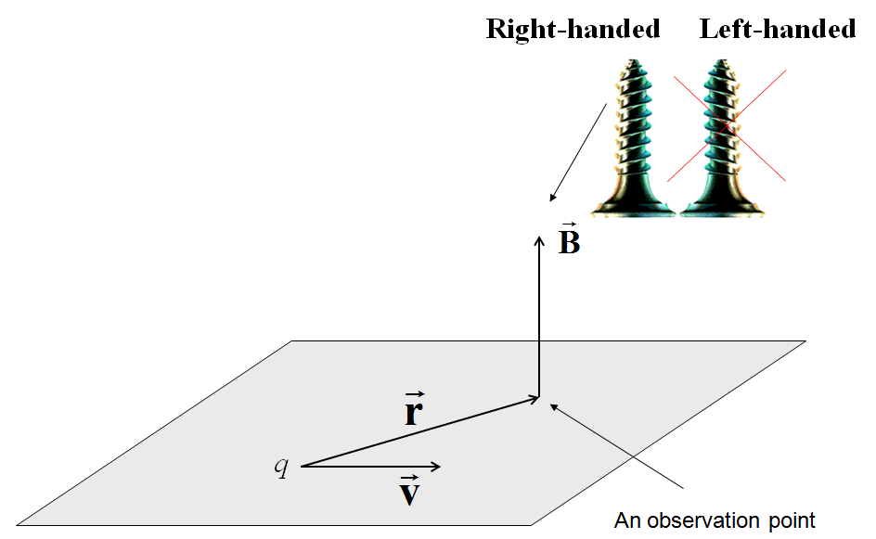
Magnetic field induced by a moving charge
(a non-relativistic particle moving much slower that the velocity of light)
The electric field is not the unique characteristic of charges. The experiments show that a moving charge q (C, Coulomb, SI) induces an additional vector field which is called the magnetic induction (T, Tesla; SI).
An observation point
q
(velocity)
− is the vector product
− is the transverse unit vector
The total magnetic induction from many moving charges can be found by the superposition principle: the vector sum of all the inductions in the system.
(H/m, Henry per meter; SI) is the vacuum magnetic constant

Slide 3
Magnetizing force
Along with the magnetic induction B, we will also use the magnetizing force H (A/m, Ampere per meter, SI). In vacuum, the magnetizing force is introduced as:
In electrodynamics, the induction vector B is always the primary magnetic quantity. You can see that in vacuum the magnetizing force H is just a formal vector which does not introduce any new information. However, in the presence of a magnetic medium, the relation between H and B will be more complicated (discussed below).

Slide 4
Lorentz force in microscopic electrodynamics
(non-relativistic particle)
A charge q moves with the velocity v in the presence of the external electric E and magnetic B fields (v, E, and B are vectors!). External magnetic induction B can be produced either by a permanent magnet or other moving charges. The total force acting on the charge:
Electrostatic force
Lorentz force
The dimension of force is N (Newton, SI).
N = kg×m /s² − dimension through the base SI units (see Appendix 3).

Slide 5
Relation between the magnetic and electric fields
(non-relativistic particle)
Electrostatic field
is the speed of light in vacuum
is the vacuum dielectric constant (F/m, Farad per meter; SI)
The dimension of electric field is V/m (Volt per meter, SI)
Due to this very small coefficient, the magnetic field effects are usually negligible in comparison with the electric field effects. However, if the electrostatic field is compensated and we have many moving charges, the magnetic field effects become dominant. This conclusion is of crucial importance for the actuator applications.

Slide 6
The magnetic induction produced by a thin straight current

Slide 7
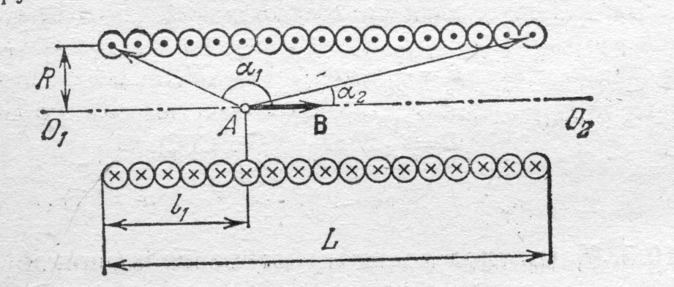
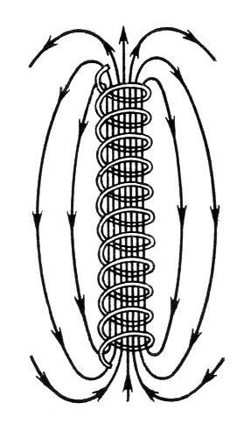
Magnetic induction in a solenoid
Here, N is the total number of turns. If the solenoid has several layers, the total magnetic induction B in a certain point inside the solenoid can be calculated as the sum of magnetic fields from each layer.
The total magnetic induction produced inside a very long solenoid (L >> R), where n=N/L is the number of turns per the unit length. Note that n = 1/d, where d is the wire diameter.

Slide 8

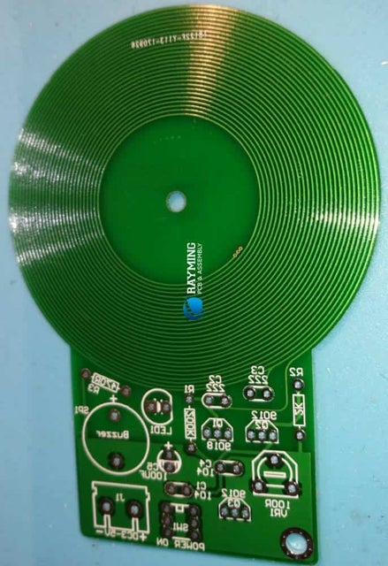
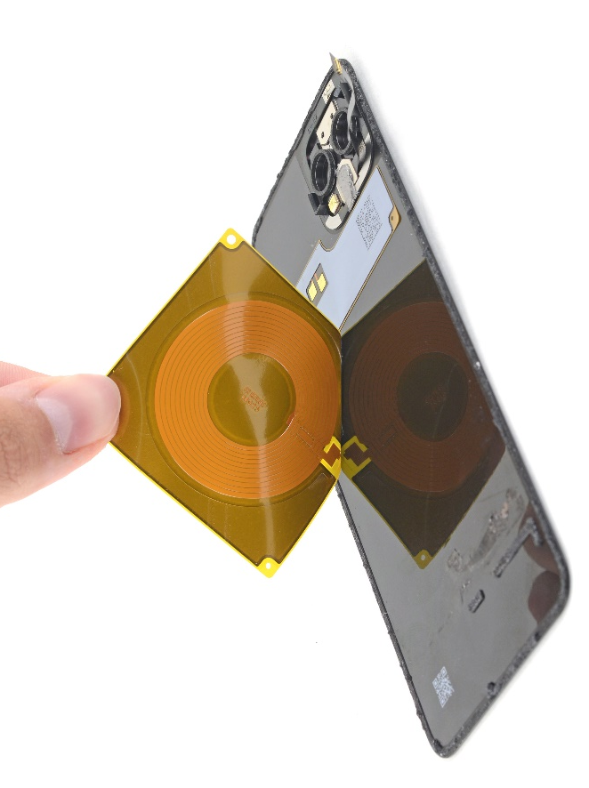
Planar magnetic coils
Microstrip planar coil
on PCB
Wire planar coil on a rigid
or flexible substrate

Slide 9
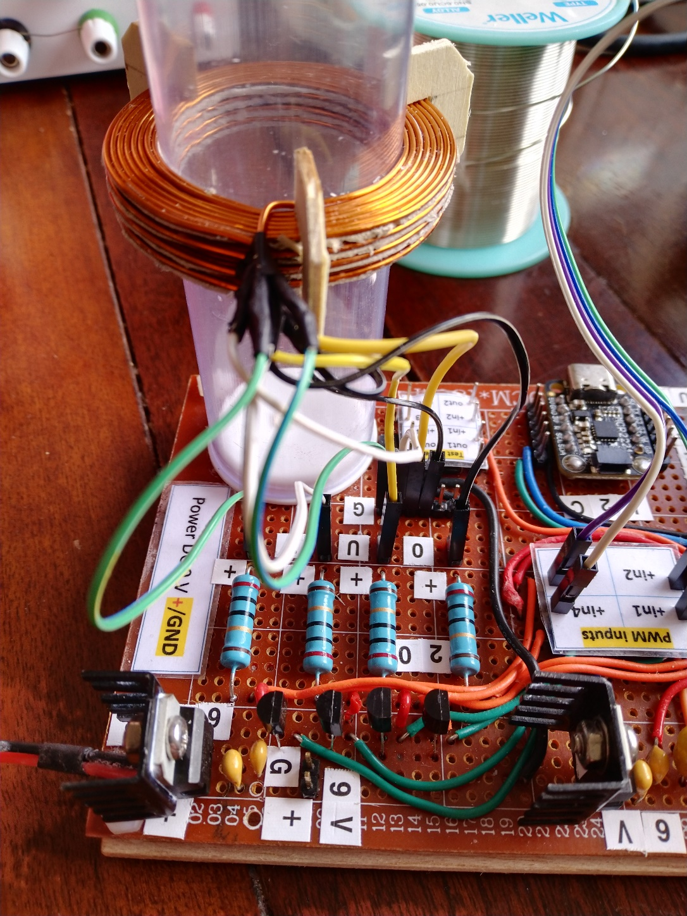
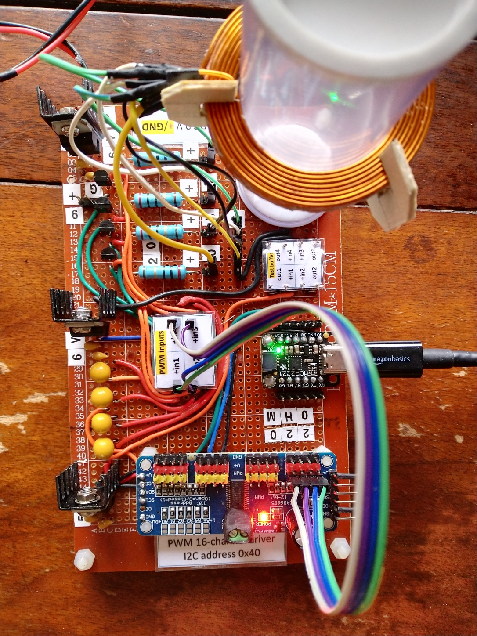
Shimming coils (stack of planar coils)

Slide 10
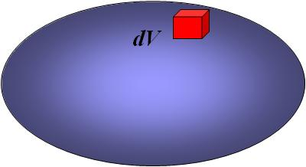
Magnetic force for continuous currents
The Lorentz force acting on a point charge q
The velocity of charges inside dV
The total magnetic force
for a volume current
The total magnetic force
for a linear current
Two conductors with the currents will interact only through the magnetic (Lorentz) force because there is no electrostatic interaction between them due to their electrical neutrality. The latter is the result of the perfect balance between the positive (nuclei) and negative (free electrons) charges inside a conductor. Despite the fact that the electric effects are much stronger than the magnetic ones (by the factor 1/c²), their full compensation makes the magnetic interaction dominant.

Slide 11
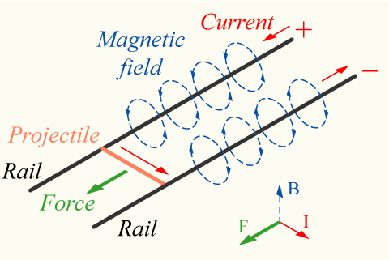
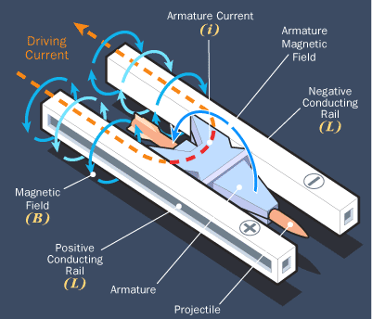
Electromagnetic railgun – an example of linear motor
Gun principle: Lorentz’s force from the rail magnetic field (circular) acts on the projectile current (series electric circuit with the same current in the projectile and rails).

Slide 12
A simple model of the electromagnetic railgun
a
L
The total resistance force (friction + air resistance)
H − acceleration distance
M – mass
Start point
I − current

Slide 13
Lorentz’s force in the railgun

Slide 14
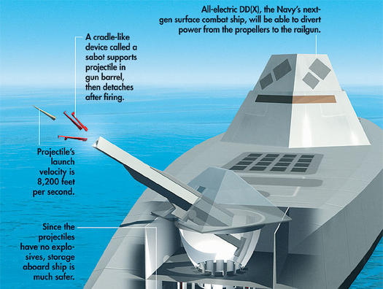
Electromagnetic railgun
http://www.youtube.com/watch?v=4OqlTXwLG40

Slide 15
The U.S. Navy is developing an electromagnetic railgun that will turn destroyers into super-long-range machine guns—able to fire up to a dozen relatively inexpensive projectiles every minute. The Navy is collaborating with the British Ministry of Defence, which has a similar effort under way. In 2003, its facility in Kirkcudbright, Scotland, hosted a 1/8-scale test of an electromagnetic railgun that produced stable flight in a projectile fired out of the barrel at Mach 6. But Capt. Roger McGinnis, program manager for directed energy weapons at Naval Sea Systems Command in Washington, D.C., estimates the U.S. version won’t be “deliverable” until 2015 at the earliest.
The technology behind the electromagnetic railgun has been around for more than 20 years, but early efforts wilted because of the huge power requirements: No ship could generate or store enough electricity to fire the gun. The concept was revived a few years ago when the Navy announced plans for its next-generation battleship, the all-electric DD(X). “In the past, destroyers had 90 percent of their power tied to propulsion,” explains McGinnis. “But with DD(X), you can divert the power to whatever you need. We can stop the ship and fire the railgun as many times as we need, then divert the power back to the screws.”
The barrel of the electromagnetic railgun will contain two parallel conducting rails about 20 feet long, bridged by a sliding armature. In the current design, electric current travels up one rail, crosses the armature, and heads down the second rail. The loop induces a magnetic field that pushes the armature, and the projectile aboard it, up the rails.

Slide 16
The challenges that remain include ensuring that the gun can target enemy sites with precision, and creating equipment that can withstand the gargantuan pressures the gun will create. “Right now, guns are only as accurate as the targeting of the bore, and now we’re talking about 200-plus-mile ranges, so there has to be aerodynamic correction,” says Fred Beach, the assistant program manager for the electromagnetic railgun at Naval Sea Systems Command. The projectile, he says, will receive course correction information from satellites and will steer itself with movable control surfaces. And because the projectile will be subjected to up to 45,000 Gs during firing, the onboard electronics must be strengthened to withstand the acceleration. Forces inside the gun itself—particularly getting the armature to move easily within the system—are also challenging the designers. “Getting two pieces of metal to slide past each other is pretty hard—we’re getting a lot of damage to the rails,” Beach says.
The electromagnetic railgun’s projectiles will cover 290 miles in six minutes—initially travelling 8,200 feet per second and hitting their target at 5,000 feet per second. Current Navy guns, which shoot powder-ignited explosive shells, have a maximum range of 12 miles and, because they are unguided, are difficult to aim. Though guided missiles, the current long-range alternative for destroyers, can achieve ranges comparable to that of the electromagnetic railgun, their cost and storage problems are what’s driving the efforts to find an alternative. Ships can only carry up to 70 guided missiles and must return to port to restock because the missiles cannot be loaded at sea, whereas railgun projectiles can easily be loaded at sea, and by the hundreds. Also appealing is that the electromagnetic railgun’s missiles do not contain volatile explosives; the weapon does its work with kinetic energy.

Slide 17
Summary
Total force acting on a point charge: Coulomb + Lorentz
Lorentz force
Magnetic induction from a point charge
Magnetic induction
from a volume current
Magnetic induction from a linear current
Magnetic force for a volume current
Magnetic force for a linear current

Slide 18
Magnetic flux through a surface
The magnetic flux (scalar!) is defined as
(Wb, Weber; SI)
External magnetic induction
Surface S
Contour
Ф is the surface integral (see Appendix 1) representing the flux of magnetic induction B through the surface S.

Slide 19
Faraday’s law

Slide 20
Two methods for changing the magnetic flux in Faraday’s law
1st method: the contour is fixed, but
the magnetic induction is changed
2nd method: the magnetic induction is fixed, but
the contour is changed

Slide 21
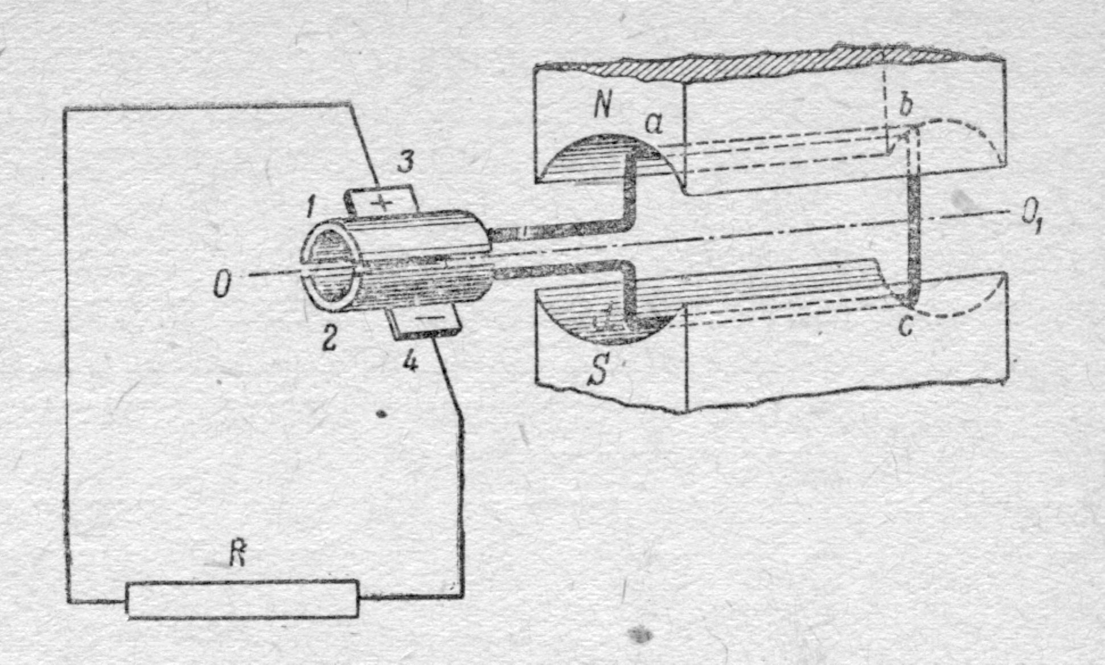
The simplest DC electric motor: current frame

Slide 22
General form of the material equation used in magnetism
M (A/m, Ampere per meter, SI) is the magnetic polarisation or magnetisation
Therefore, inside a magnetic material along with the external induction μ₀H there is an additional magnetic induction μ₀M. This additional induction is produced by the magnetic atoms – “elementary magnets”. In ferromagnetic materials, the magnetisation M can exist even without an external magnetising force – the so-called “spontaneous” magnetisation. In the presence of an external magnetising force, M is a non-linear function of H.

Slide 23
Linear magnetic response
For weak fields, the relation between the magnetic induction and the magnetising force may become approximately linear:
μ (dimensionless) is the permeability matrix
This linear relation is used in high frequency applications operating with very weak fields: ferrites in waveguides and antennas, spin waves, magnetoimpedance sensors, and so on. But, it is not adequate for actuators where the fields are usually strong or very strong.
Non-linear magnetic media
In general case, the magnetic induction will be a non-linear function of the magnetising force. For the magnetic induction measured in the direction of an external magnetising force, we can introduce the following permeabilities:

Slide 24
Non-linear functions typical for ferromagnetic materials

Slide 25
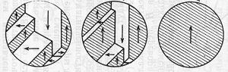
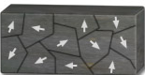
Magnetic domains in ferromagnetic materials
Despite the fact that a ferromagnetic material used in practice usually contain many “elementary magnets” (magnetic atoms), the spontaneous macroscopic magnetisation M of the whole sample may be much smaller than in the presence of a strong magnetising force. This experimental fact is explained by the domain structure. Inside a ferromagnetic material, there are many areas, called “domains”, where all the elementary magnets have the same magnetisation orientation, but this orientation is different in the different domains. Therefore, the magnetic induction produced by one domain is partly or completely compensated by surrounding domains. The typical domain size is ~ 10 ‒ 100 μm, and hence it includes many atoms.
Zero magnetising force
Saturation
Appling an external magnetising force, we will increase the total volume of the domains having the preferred direction along the magnetising force. This process is realised through the rotation of the magnetisation vectors inside each domain and also the movement of domain walls – thin transition regions between domains where the magnetisation changes its direction. Finally, for a sufficiently strong magnetising force, called the saturation field, the domain walls will be eliminated and all elementary magnets will have the same orientation along this magnetising force. Reducing the magnetising force below the saturation level, a new domain structure will appear again.

Slide 26
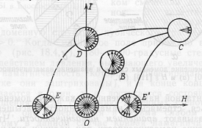
Magnetisation reversal in a ferromagnetic sample
The magnetisation orientation of domains in percentage terms (“pie chart”).
Magnetic
field
Magnetic
field
H

Slide 27
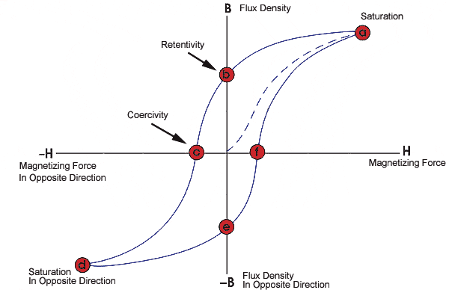
The main features of magnetisation reversal
Low coercivity or “soft” magnetic materials have a narrow hysteresis loop. Applications: magnetic circuits and cores, transformers, electric motors, electromagnets, relays.
High coercivity or “hard” magnetic materials have a wide hysteresis loop. Applications: permanent magnets, magnetic tapes, hard discs.
M
Magnetic
field
Magnetic
field
Hysteresis curve
Magnetic
field
Magnetic
field

Slide 28
Appendix 1: the vector product
Calculation
-
-
α − is a real number
“Right-hand screw rule” shows the direction of the vector product, when r₁ is rotated towards r₂
Geometrical interpretation
τ − is the normalised (unit) vector showing the direction of vector product.

Slide 29
Appendix 2: scalar product
Calculation
r₁
r₂
angle
Geometrical interpretation

